Slide 1
Case Study: Automotive HUD
David Hasenauer and Bruce Irving
Synopsys Optical Solutions Group
May 2016

Slide 2

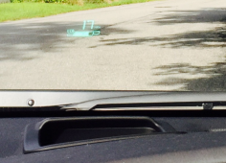
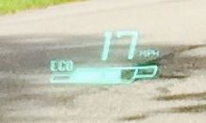
Why Are Automotive HUDs Interesting?
First available in 1988. Available today on many car models, with the number of models increasing
  Projected growth from about 4 million units in 2015 to 9 million units in 2020 (IHS Automotive)
Optics:
  Typically require tilted/decentered optics
  May require freeform surfaces:
    Variable, when the beamsplitter/combiner uses a custom optic
    Fixed, when the windshield is used as the beamsplitter/combiner
  May also use diffractive surfaces, micro-optics, special coatings, etc.
  Performance specifications based on the two-eye, human visual system

Slide 3
Goals for this Case Study
Develop an automotive HUD system…
  Discuss how to model the windshield
  Utilize full field display analysis to visualize performance
  Use clearance control constraints and free-form surface optimization to improve the system
  Design/Analyze to visual performance specifications
  Show other useful features, techniques, troubleshooting

Slide 4
Design Process
Define the Optical & Mechanical Specifications

Slide 5
Optical Specifications:
Parameter | Target Value
Wavelengths (nm) | 656.3 – 435.8
Field of View | ± 6° H x ± 4.5° V
Eye Box (mm) | 100 H x 80 V
Display Size (mm) & Pixel Density (similar to an iPhone 6 Plus) | ± 61 H x ± 34 V (Used: ± 45 H x ± 34 V) 1920 x 1080 at 64 μm pitch
Display NA | ~ 0.12 (f/4.3) (based on optical invariant)
Eye pupil (mm) | 4
Interpupillary Distance (mm) | 56 – 72 (average 64)
RMS Spot Sizes (arc minutes) | < 3
Max Distortion (%) | < 5
Focus Distance (diopters) | 0.167 (i.e., 6-meters, forces positive accommodation
Convergence Disparity (degree) | < 1 (~0.25 diopter at a focus of 0.167d)
Dipvergence (arc minutes) | < 5
Field curvature (diopters) | < 1
Astigmatism (diopters) | < 0.25
Notes:
Mention verbally, that you would need 50% more pixels over the same format to get the pixel size sub-arc minute.

Slide 6
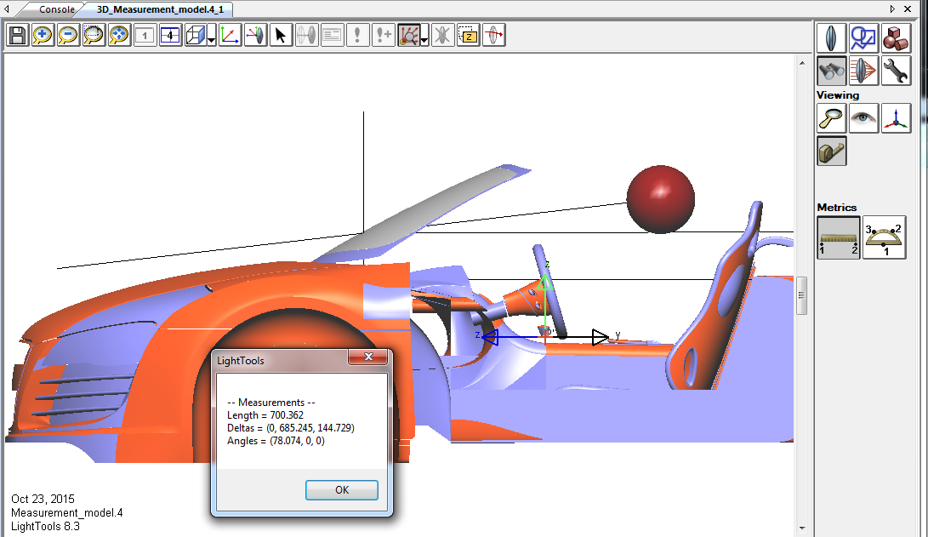
Packaging
Utilize CAD import & measurement tools to determine:
  Eyebox to windshield distance
  Approximate angle of incidence on windshield
  Windshield to dashboard distance

Slide 7
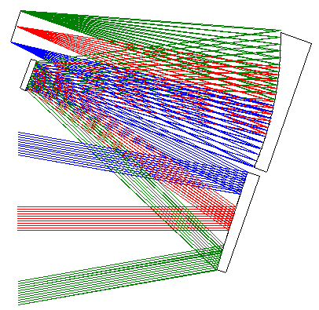
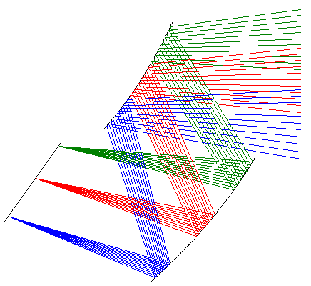
Packaging
Under the dashboard, we’ll need to keep the systems as compact as possible
We’ll consider folded geometries

Slide 8
Packaging Specifications:
Parameter | Target Value
Beamsplitter/Combiner | Windshield
Below Dashboard limits (mm) | Minimize
Tilt of Windshield from Vertical (from CAD model) | 50°
Angle of incidence on Windshield (from CAD model) | ~ 60°
Distance from Windshield to Eyebox (mm - from CAD model) | 700
Distance from Dashboard to Windshield (mm - from CAD model) | 165
Notes:
I did cheat on this a bit. 700 mm is a reasonable spec for the eyebox to combiner distance, however, per the CAD drawing it should be closer to 900 mm for this example.

Slide 9
Design Process
Modeling the Windshield

Slide 10
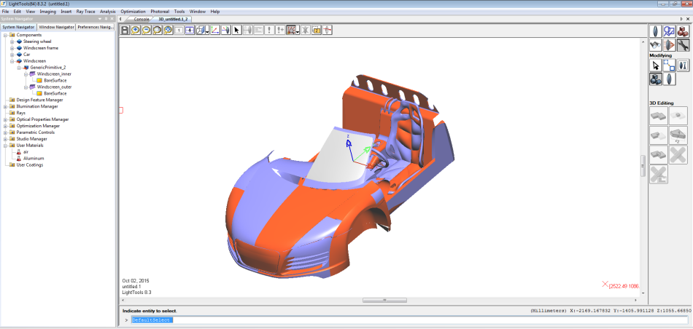
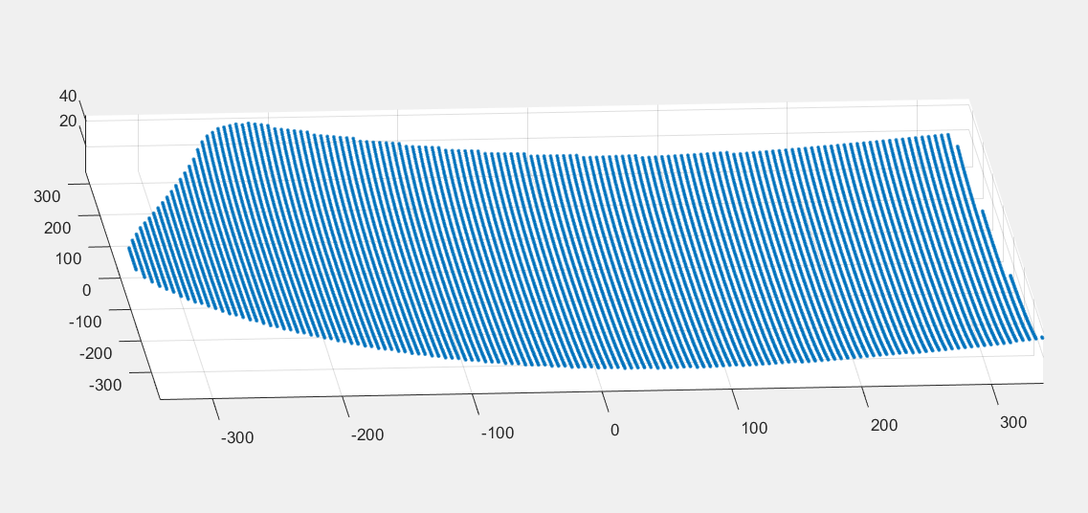
Windshield
If the windshield will be used as the combiner, the shape must be modeled for ray tracing
Create a sag map for the area of the windshield that will interact with the optical beam:
  Use the SAGFIT function optimization macros to fit the sag data to a native CODE V surface

Slide 11
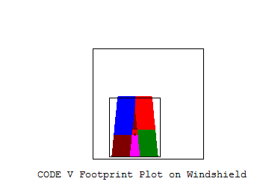
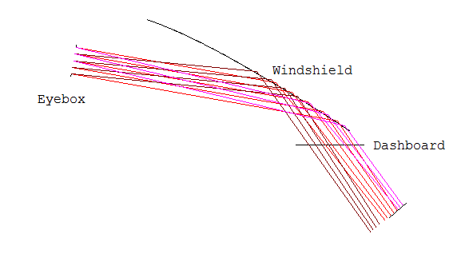
Windshield Footprint
To determine the optical footprint on the windshield, set up a simple model with eyebox, a flat windshield, appropriately oriented, and run CODE V’s FOOtprint option
  Vignetting from bottom of windshield
Footprint on Windshield, facing the driver

Slide 12
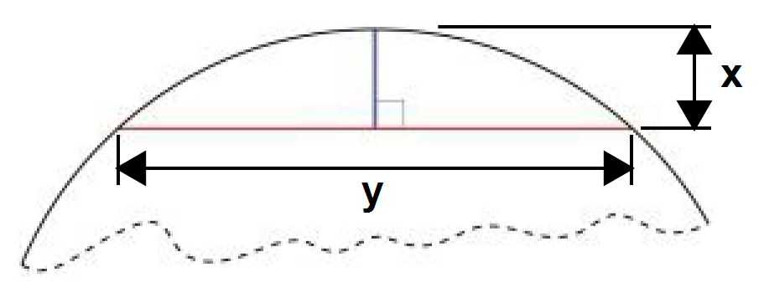
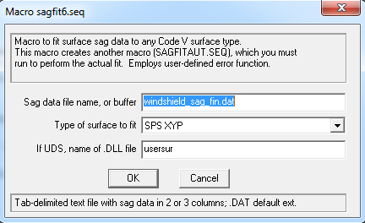
Creating the Sag Map
z
We only fit the sag data over the optically useful footprint area
of the windshield for maximum accuracy
SAGFIT macro creates a User-defined Error Function (UDEF) in AUT to vary the coefficients for any supported CODE V surface type, optimizing to fit a 1D or 2D sag map
Fit to XY Polynomial surface was used

Slide 13
Design Process
Start with a simplified model and build to a solution

Slide 14
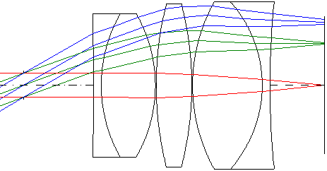
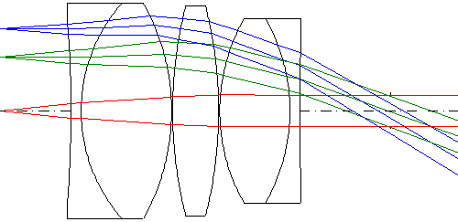
Similar to Eyepieces, HUDs can be designed in one of two orientations
  Eye to Display:
    Object distance = ~ ∞
    Stop (eye pupil) at S1
  Display to Eye:
    Finite object distance
    Requires afocal handling
Pros – Eye to Display | Pros – Display to Eye
Eyebox dimensions easily defined | No Conversion required to visual performance specs (use True Afocal Modeling, AFC)
Angular field easy to define | AFC naturally handles eye accommodation over field
 | Models the real eyebox which is typically variable with field angle (vignetting)
We use the Eye-to-Display for set-up/design & Display-to-Eye model for analysis

Slide 15
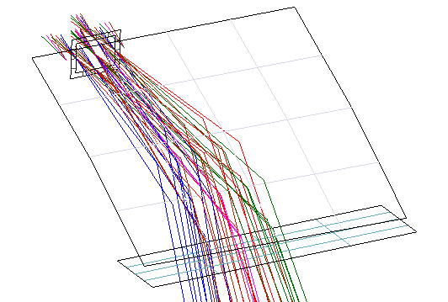
Step 1: Get correct relationship among the Eyebox, Windshield, and Dashboard
The only “powered” optic at this point is the windshield. The approximate size of the (½) windshield is shown in the V3D model, but recall that we only fit the XY-polynomial over the optically used area, so it appears flatter than the full windshield model.

Slide 16
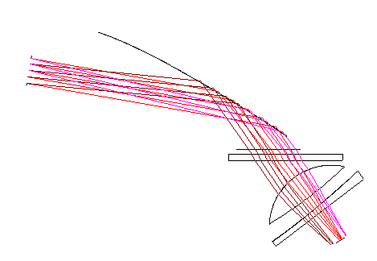
Step 2: Design an “in-line” reflective or refractive system
The idea was to get “roughly” in-line solution and then work on folding it for compactness
This proved to be very, very difficult (i.e., impossible!)
We tried:
  Lens modules
  Plastic refractive optics with high-order, decentered aspheric corrector plates
  Zernike reflective surfaces; etc.
Nothing seemed to work! What was going wrong!?

Slide 17
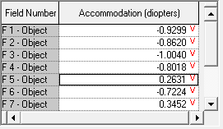
Windshield Challenges
How much is the windshield contributing to aberrations?
  Answer: A lot!
True afocal modeling (AFC)
Optimize independent accommodation (focus) over field
Analyze spot diagram (SPO)

Slide 18
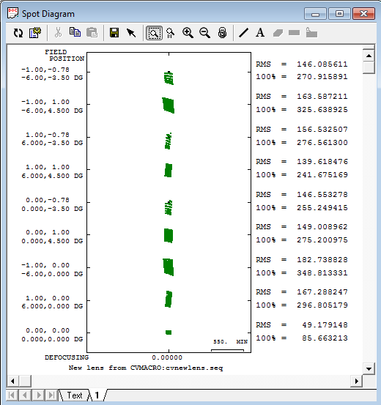
Windshield Analysis Results: Full Eyebox
The spots are huge, between 86 and 325 arc-minutes in size!
  Additionally, the change in accommodation for different fields was significant
  However, this analysis is over a pupil size corresponding to full eyebox rather than real eye pupil of 4-mm

Slide 19
Windshield Analysis Results: Real Eye Pupil
Eyebox
100 mm
64 mm
80 mm
4 mm
Model realistic eye pupil (64-mm IPD)
Windshield blurring is still 2’ to 20’, over the field
Large aberrations are still there but represent significant changes to local aberrations vs. eye position
Given the distance between the windshield and the first opportunity for corrective optics, it will be very difficult to use the windshield as a viable combiner. This windshield could potentially still be used assuming a different approach, for example, if the display is reimaged to reduce the footprint on the windshield, or, if the eyebox size where both eyes can see the display, is reduced. We chose not to do this for this case study.”

Slide 20
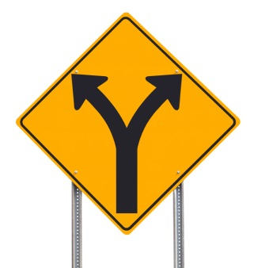
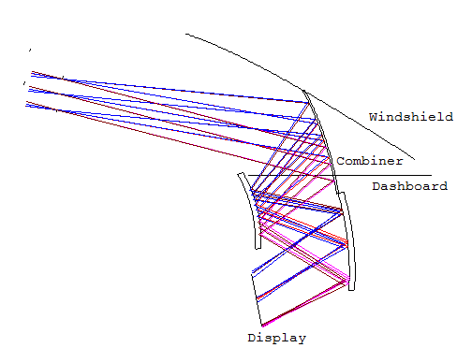
Step 3: Come up with a different approach!
To be successful with a real pupil at the eyebox, we need to control the optical quality of the combiner
An Offner configuration with a dedicated combiner optic provides a good solution in a compact configuration
We ray trace from eyebox to display for optimization

Slide 21
Design Process
Determine Optimization Variables and Constraints

Slide 22
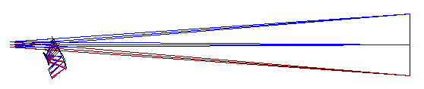
Variables & Constraints
AUT
  The object distance is set at -6000 (i.e., 0.167 diopters)
Variables include:
  Appropriate curvatures, thicknesses, Y-decenters & Alpha-tilts
  Based on the off-axis configuration, we will use “free form” Fringe Zernike surfaces (SPS ZFR) with the primary and secondary terms variable
    Since the displacement is purely in Y, the variables include a subset of the ±X symmetric Zernike fringe coefficients : 5th, 8th, 9th, 11th, 12th, 15th, 16th, 17th & 20th
    The normalization radius will be allowed to vary to remain larger than the bundles
Constraints include:
  Image Scale
  Clearance constraints
  Normalization radius control
Notes:
By eliminating the windshield we can take advantage of symmetry about the YZ-plane. This simplifies many aspects of this problem.

Slide 23
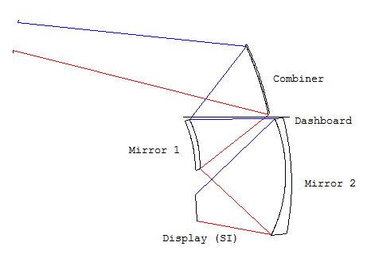
User-defined constraints (UDCs) for clearances
Use global coordinates of the Dashboard & the “Point-Line” clearance control available via @JMRCC()
F4 R2
F5 R3
@clr_cd == (z F5 R3 G"Dashboard" S"Combiner")
@clr_cd > 7
@clr_m1d == (z F4 R2 G"Dashboard" S"Mirror 1")
@clr_m1d < -7
@clr_m2d == (z F4 R2 G"Dashboard" S"Mirror 2")
@clr_m2d < -7
!Clearance between Ray from Mirror 1 & Image
! Line = R3 F5 S"Mirror 1" (4) & Point = R2 F4 SI (6)"
@clr_m1i == @jmrcc(3,5,4,2,4,6,0,0)
@clr_m1i < -10

Slide 24
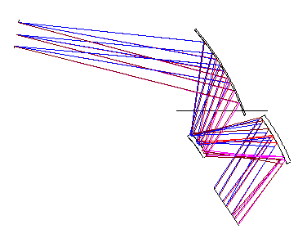
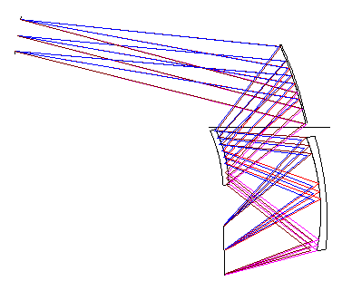
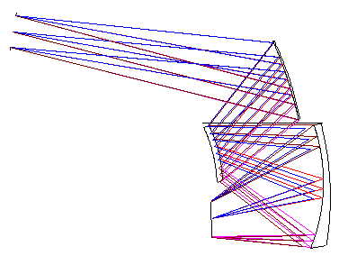
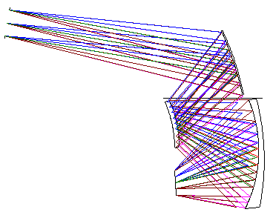
Optimization Strategy
AUT
Start with all-spherical surfaces, 6-fields (on-axis) and periphery, and optimize for packaging
Freeze tilts/decenters on selected components as clearances are achieved
Allow primary Zernike aberration coefficients to be variable; use weak constraint on display size
Allow secondary Zernike aberration coefficients to be variable; tighter control on display size
Finally, add additional fields and optimize
CODE V can often be quite successful when defining all variables and all constraints in a single run; this system required a more iterative approach to be successful

Slide 25
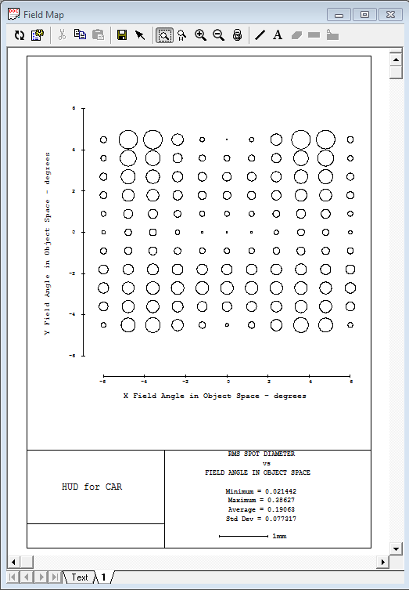
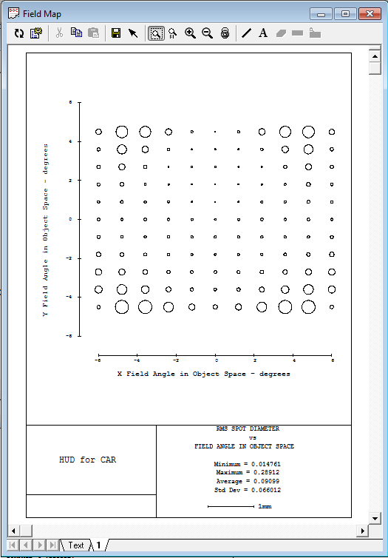
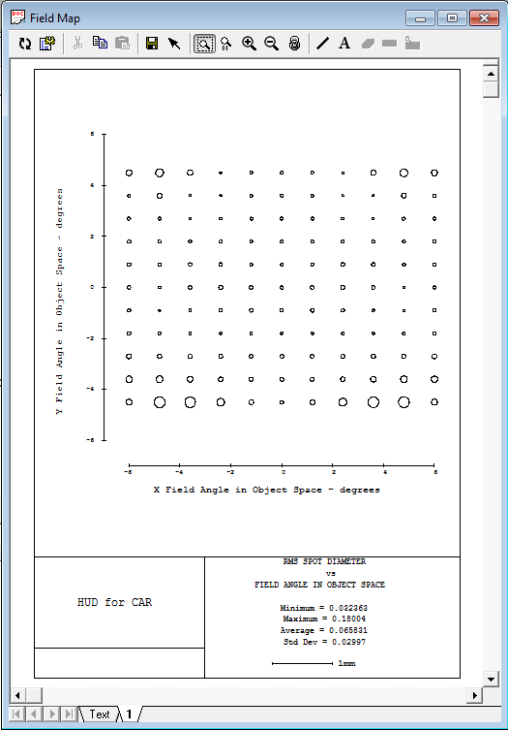
Verify Adequate Field Sampling
Particularly important for “free-form” surface systems
The Analysis > Diagnostics > Field Map (FMA) feature is ideal for evaluating this:
Because of symmetry, only ½ of the field of view needs to be modeled
System optimized for 6-fields. Average Spot ~0.191 mm
System optimized for 11-fields. Average Spot ~0.091 mm
System optimized for 15-fields. Average Spot ~0.066 mm

Slide 26
Design Process
Optimization Result

Slide 27
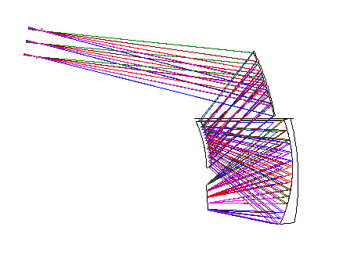
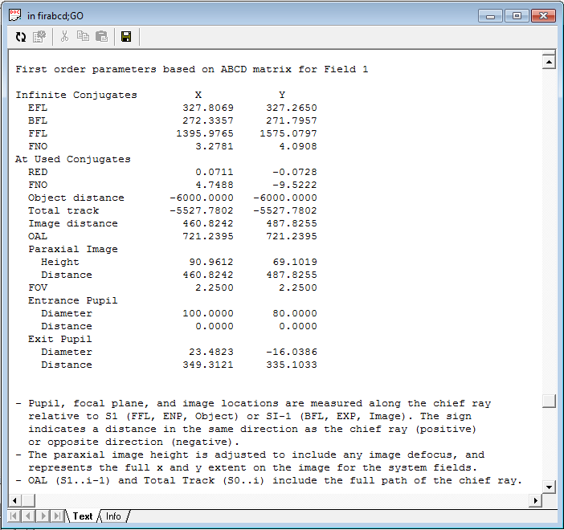
System Evaluation
We can use the system 1st order properties to estimate the visual blurs
From the FMA spot size analysis the average spot size is 0.066 mm and the maximum is 0.18 mm.
Using the reduction ratio value of ~0.072 from the ABCD computation the average spot size corresponds to about 0.5’ to the eye, with the maximum blur of ~1.5’
Notes:
A 10.8 feature

Slide 28
What aberrations dominate?
Use FMA to evaluate Zernike aberrations
Primary Astigmatism (Scale 43-waves)
Primary Coma (Scale 13-waves)
Primary Spherical (Scale 6-waves)

Slide 29
What aberrations dominate?
Use FMA to evaluate Zernike aberrations
Primary Trefoil (Scale 12-waves)
Secondary Astigmatism (Scale 7-waves)
Secondary Coma (Scale 4-waves)

Slide 30
What aberrations dominate?
Use FMA to evaluate Zernike aberrations
Secondary Spherical (Scale 0.7-waves)
Primary Tetrafoil (Scale 6-waves)
Secondary Trefoil (Scale 2-waves)
Notes:
All other aberrations had scale bars < 1 wave

Slide 31
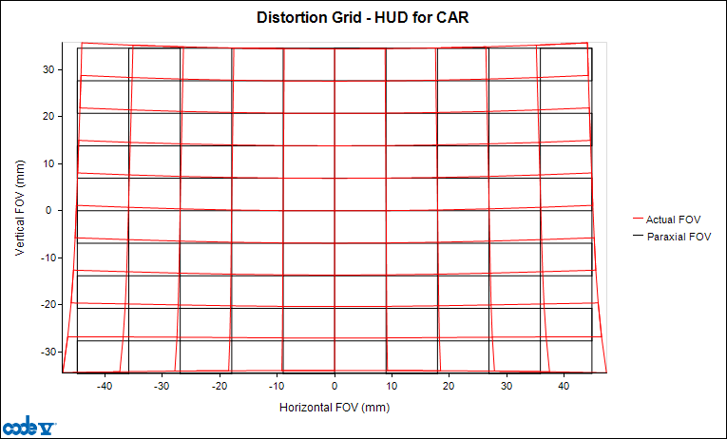
Distortion
Using the Analysis > Diagnostics > Distortion Grid analysis, the distortion is < 5% across the field of view
The distortion remains relatively constant as the eye pupil is moved around the eyebox

Slide 32
Design Process
Analyze the Visual Performance

Slide 33

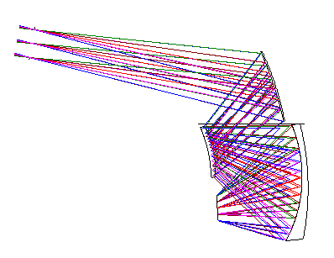
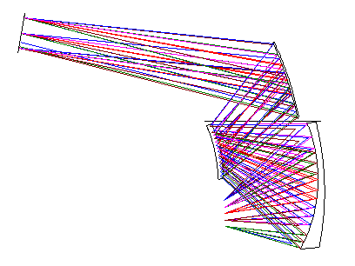
Reverse the System
Reversing the system to trace from display to eyebox allows easier use of visual analysis methods
Use of global coordinates can sometimes be helpful in reversing decentered systems
Eyebox to Display
Display to Eyebox

Slide 34
Convergence Disparity & Dipvergence
Horizontally, eyes have the ability to converge, but not diverge
  Both eyes should converge to the same distance as the focus distance, or a sensation of depth is created
Vertically, the eye angles should be the same
  Dipvergence > 5’ (0.08 deg), causes eye strain
Incorrect angle
Incorrect depth
Top View
Side View (exaggerated angle)

Slide 35

With the system flipped, we can easily model and analyze the performance for both eyes
We want to analyze visually:
  RMS Blur size; Convergence disparity; Dipvergence; Field Curvature & Astigmatism
Create two zoom positions with 4-mm apertures separated by the desired interpupillary distance, and true afocal modeling (AFC)
  Use real chief ray data to analyze convergence and dipvergence errors
  Use RMSSPOT() macro function to analyze RMS blur size
  Use (XFO) and (YFO) database items to analyze field curvature and astigmatism

Slide 36

Macro-PLUS to the rescue!
For convenience, a macro was created to analyze and display all the parameters on the prior slide
in hud_visual_analysis IPD HeadPosX HeadPosY
IPD: Interpupillary Distance
HeadPosX/Y: Coordinate of the midpoint
between the eyes
The following combinations were analyzed:
  IPDs: 56, 64, 72 mm
  Head position in the eyebox: X = -15, -7.5 0, +7.5, +15 mm &
  Y = -36, -18, 0 +18, +36 mm
  Display positions: X = 0, +22.5, +45 mm &
  Y = -34, -17, 0.0, +17, and +34 mm

Slide 37
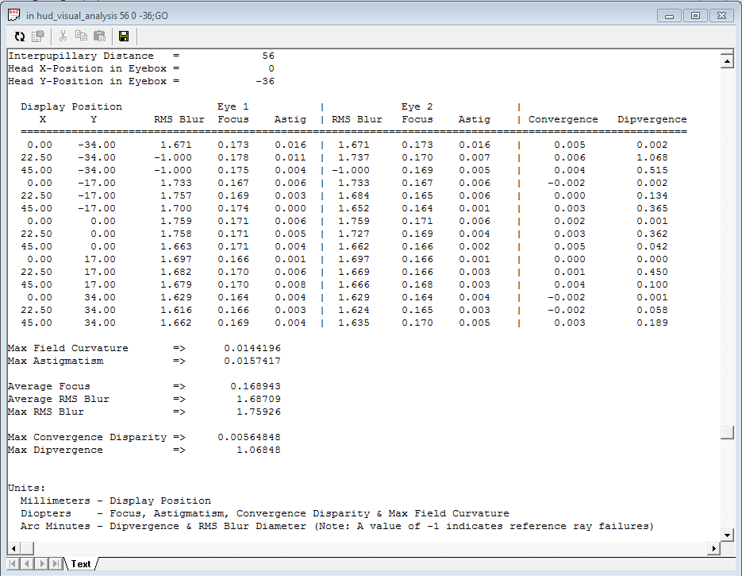
Example Output

Slide 38
Final Performance:
Parameter | Target Value | Performance
RMS Spot Sizes (arc minutes) | < 3 | 1.7 average; 1.8 max
Max Distortion (%) | < 5 | < 5
Focus Distance (diopters) | 0.167 | 0.166 – 0.172
Convergence Disparity (diopters) | < 0.25 | 0.01 max
Dipvergence (arc minutes) | < 5 | 2.34 max
Field curvature (diopters) | < 1 | 0.04 max
Astigmatism (diopters) | < 0.25 | 0.03 max

Slide 39
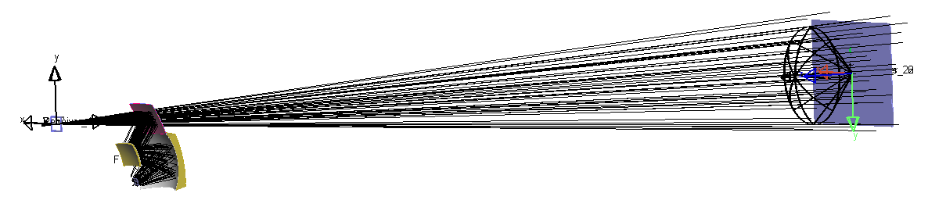
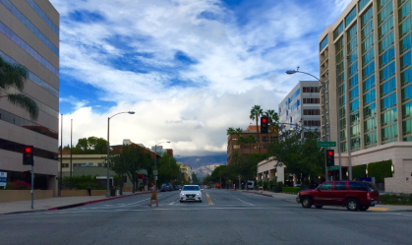
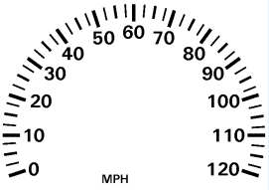
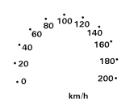
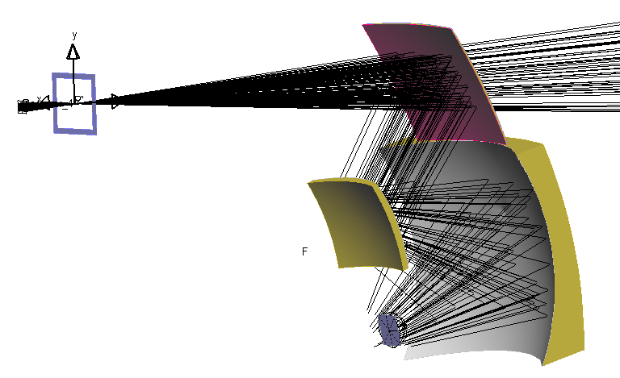
With LightTools, the view through the HUD can be simulated
Backwards ray trace used for efficiency to create a pinhole image
Scene: 3 sources (R+G+B)
Display: 2 sources (R + G)
Rays split at combiner
HUD Geometry Exported from CODE V using LightTools Export (LTE)

Slide 40
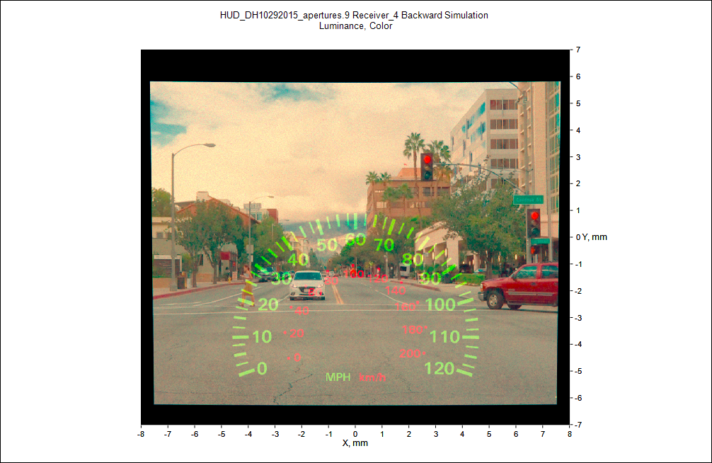
LightTools Color Spatial Luminance Visualization

Slide 41
Lessons Learned
How to model a windshield in CODE V
How to optimize to maintain clearances between optical bundles and components
How to use the Field Map feature (FMA) to evaluate the field sampling for optimization & visualize aberrations for non-symmetric systems
How to analyze binocular (two eye) specifications

Slide 42
Appendix: Telecentricity
While not a requirement, we’d prefer telecentric imaging to avoid illumination issues with the display
  Use custom macro TELECENTRICFFD.SEQ (available on the customer portal)
The variation is significant, from about 0° to 44°, and of serious concern for a practical design.
Time did not allow this to be addressed but a solution would certainly add to the system complexity

